Slide 1
Advanced statistical methods
SUBMITTED BY :
Dr.A.Britto Manoj Sir

Slide 2
Batch No-08
231FA23008 – A.BHARGAV RAM
231FA23020 – A. PRADEEP SRI MANI TEJA REDDY
231FA23048 – K. KALANJALI
231FA23052 –K. SRI KARTHIKEYA REDDY

Slide 3
A company keeps records of accidents. During a recent safety review, a random sample of 60 accidents was selected and classified by the day of the week on which they occurred.
Day: | Mon | Tue | Wed | Thu | Fri
No. of accidents | 8 | 12 | 9 | 14 | 17
a.) Write the parameter of interest
b.) Test the level of significance at 5% level.
c.) Test whether there is any evidence that accidents are more likely on some days than others.

Slide 4
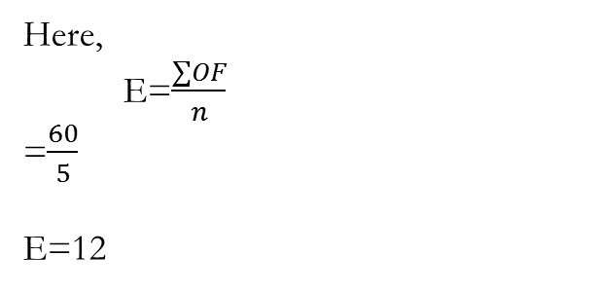

Given
1)The parameter of interest is chi-square(x^2)
2)Ho: The accident are equally occurred on any day of the week
3)H1:The accident are not equally occurred on any day of the week
4) α=0.05
n=5
d.f=n-1
=5-1
= 4
Tab x^2=9.49
5)Test statistics x^2= ∑$\frac{\text{(}\text{O}\text{ −}\text{E}\text{)^2}}{E}$
Here,
E=$\frac{∑OF}{n}$
=$\frac{60}{5}$
E=12

Slide 5
6)Reject Ho at x^2>9.49
Accept Ho at x^2<9.49
7)calculation:
Day | O | E | O-E | (O-E)^2 | (O=E)^2/E
Mon | 8 | 12 | -4 | 16 | 1.33
Tue | 12 | 12 | 0 | 0 | 0
Wed | 9 | 12 | -3 | 9 | 0.75
Thu | 14 | 12 | 2 | 4 | 0.33
Fri | 17 | 12 | 5 | 25 | 2.08
(O=E)^2/E=4.49

Slide 6
8)conclusion:
Cal x^2=4.49
Tab x^2=9.49
Cal x^2 < tab x^2
We Accept Ho at 0.05 of LOS
The accident are equally occur in any day of the week

Slide 7
Thank you

